Slide 1
CONNECT Release 4.6
Demo and Updates
Deepthi Rodrigues (Functional Lead)
Jason Smith (Project Manager)

Slide 2
CONNECT - eHealth Exchange Validated
CONNECT is now an eHealth Exchange Validated System
http://sequoiaproject.org/ehealth-exchange/testing-overview/ehealth-exchange-validated-products

Slide 3
CONNECT Update – Audit Logging
Features – Release 4.6
Benefits
ATNA compliant audit entries
Persisted to database/log file
Query capabilities from System Administration module
Extensible Audit framework
Introducing asynchronous design to CONNECT
PD,QD,RD,DS,X12 services
Compliance with specifications
Successful onboarding and validation
Flexibility to support multiple audit options
Support troubleshooting and transaction review
Performance implications considered
Notes:
DSR Notes-
Compliance with the NwHIN and underlying IHE specifications for audit messages for eHealth Exchange participants and other CONNECT adopters.
Participants in the eHealth Exchange onboard successfully and produce ATNA compliant audit messages for gateway transactions.
Providing flexibility to adopters as multiple options for auditing are supported.

Slide 4
CONNECT Demo – Audit Logging
Notes:
Search/view audit events using System Administration module

Slide 5
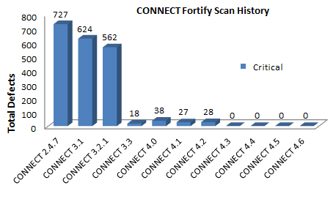
CONNECT Update: Security Testing Update
Progression resolving security findings
Process Improvements
Improvements in coding practices and security scanning methods
Proactive, collaboration with SCQC(DOD), early discovery
Maintain ZERO Critical, Highs and Mediums vulnerabilities
Introduced SonarQube and OWASP Dependency checks
Improved documentation

Slide 6
CONNECT Update: Performance Testing
Performance Testing update
Continues to meet and exceed throughput message requirements at the gateway across services (PD,QD,RD,DS)
Tested X12 for the first time and met numbers
Met 2000+ messages per minute across all services
Results can be found here - https://connectopensource.atlassian.net/wiki/x/FIAvAw

Slide 7
CONNECT 4.6 Release Documentation

Slide 8
CONNECT 4.6
4.6 - https://connectopensource.atlassian.net/wiki/x/C4ByAg
Release Notes
https://connectopensource.atlassian.net/wiki/x/B4AHAw
Binaries
https://connectopensource.atlassian.net/wiki/x/OYCaAw
Installation Documentation
https://connectopensource.atlassian.net/wiki/x/PIDcAg
Release Testing Documentation (incl. Performance Testing)
https://connectopensource.atlassian.net/wiki/x/GYC_Ag
Source Code
https://connectopensource.atlassian.net/wiki/x/KICh

Slide 9
Current CONNECT Partner environments

Slide 10
Questions? federal.health@hhs.gov

